Slide 1
Data Structures
ICT-1211
Information and Communication Technology
Lecture-10
Date:

Slide 2
Linked Lists

Slide 3
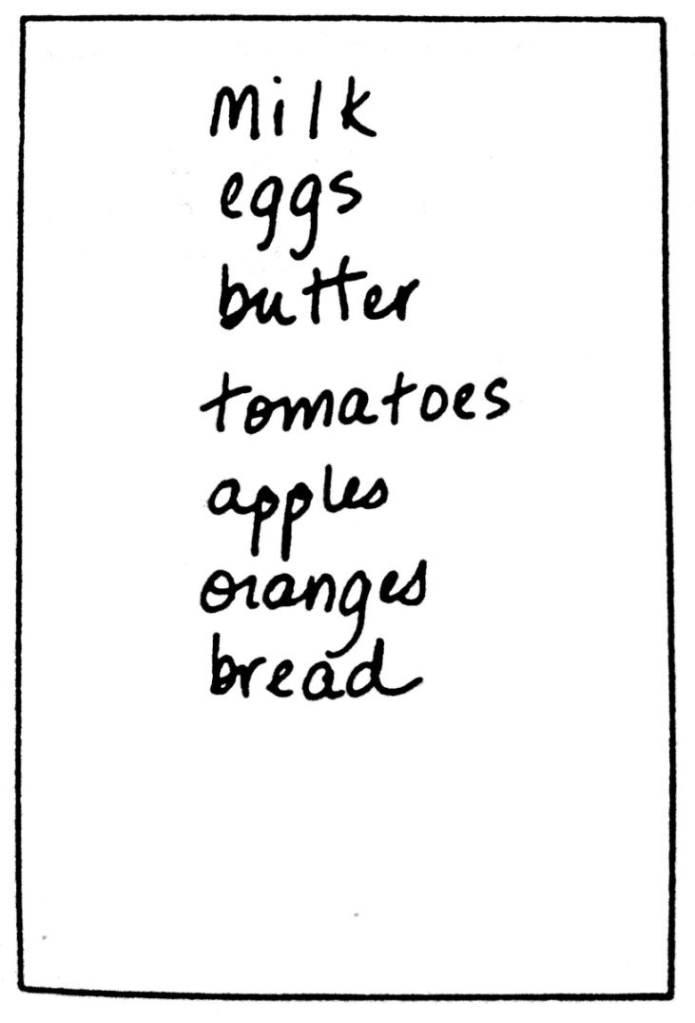
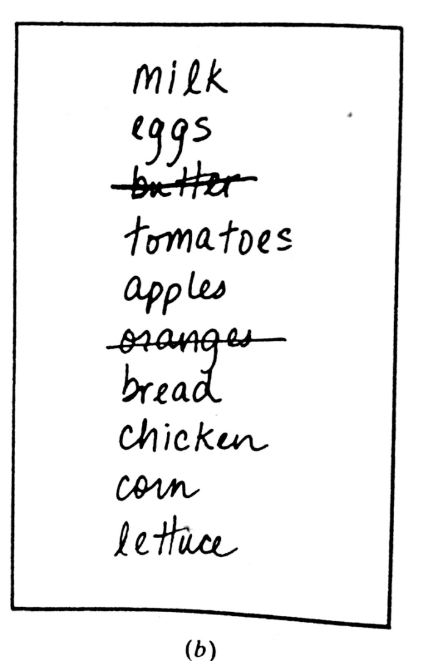
LINKED LISTS: Introduction
Notes:
The linear relationship between the data elements of an array is reflected by the physical relationship of the data in memory, not by any information contained in the data elements themselves.

Slide 4

LINKED LISTS: Introduction
In linear array…....,
The linear relationship between the data elements of an array is reflected by the physical relationship of the data in memory, not by any information contained in the data elements themselves.
It is easy to compute the address of an element in an Array.
Arrays have certain disadvantages:
      It is relatively expensive to insert and delete elements in an array,
      One can not simply double or triple the size of an array when additional space is required.
For this reason,
Arrays are
called Dense lists, and
said to be Static data structure.

Slide 5
LINKED LISTS:
Start
Pointer
List
Link
8
AMIRUL
PINTU
MOSTAFIZUR
ROKSANA
ANAMIKA
SHAHARUL
IMRAN
MASUM
6
1
7
5
2
3
0
4
1
2
3
4
5
6
7
8
LINKED LIST

Slide 6
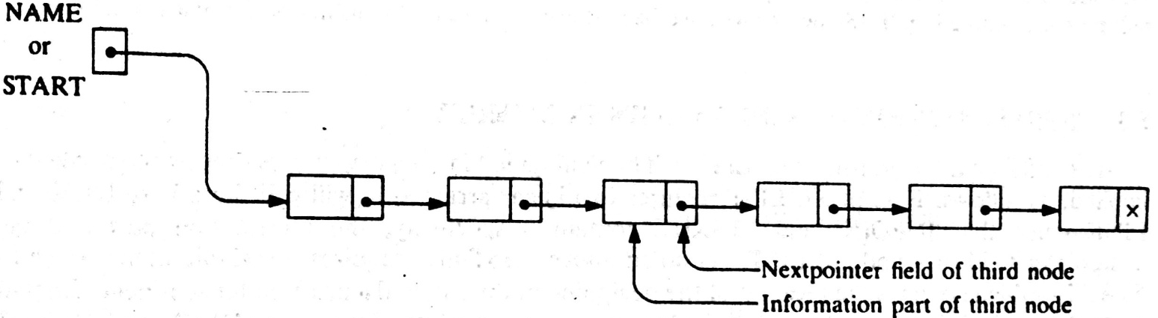
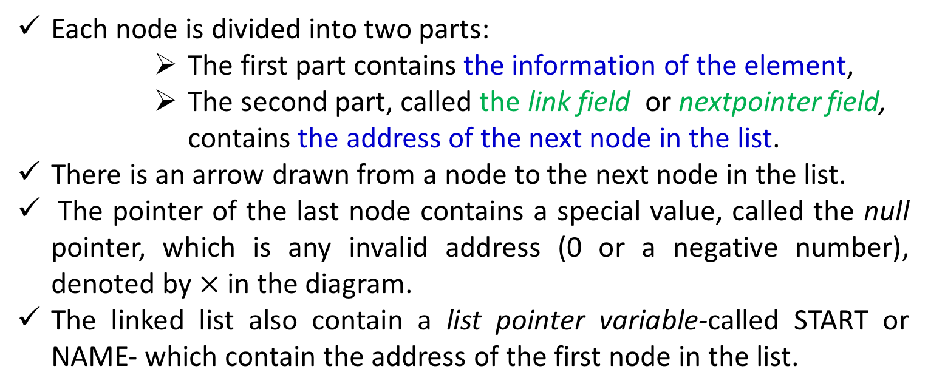
LINKED LISTS: Definition
A linked list, or one-way list, is a linear collection of data elements, called nodes, where the linear order is given by means of pointers.
Each node is divided into two parts:
      The first part contains the information of the element,
      The second part, called the link field or nextpointer field, contains the address of the next node in the list.
There is an arrow drawn from a node to the next node in the list.
The pointer of the last node contains a special value, called the null pointer, which is any invalid address (0 or a negative number), denoted by $×$ in the diagram.
The linked list also contain a list pointer variable-called START or NAME- which contain the address of the first node in the list.
Notes:
There is an arrow drawn from START to the first node. Clearly, we need only this address in START to trace through the list. A special case is the list that has no node . Such a list called the null list or empty list and is denoted by null pointer in the variable START.

Slide 7
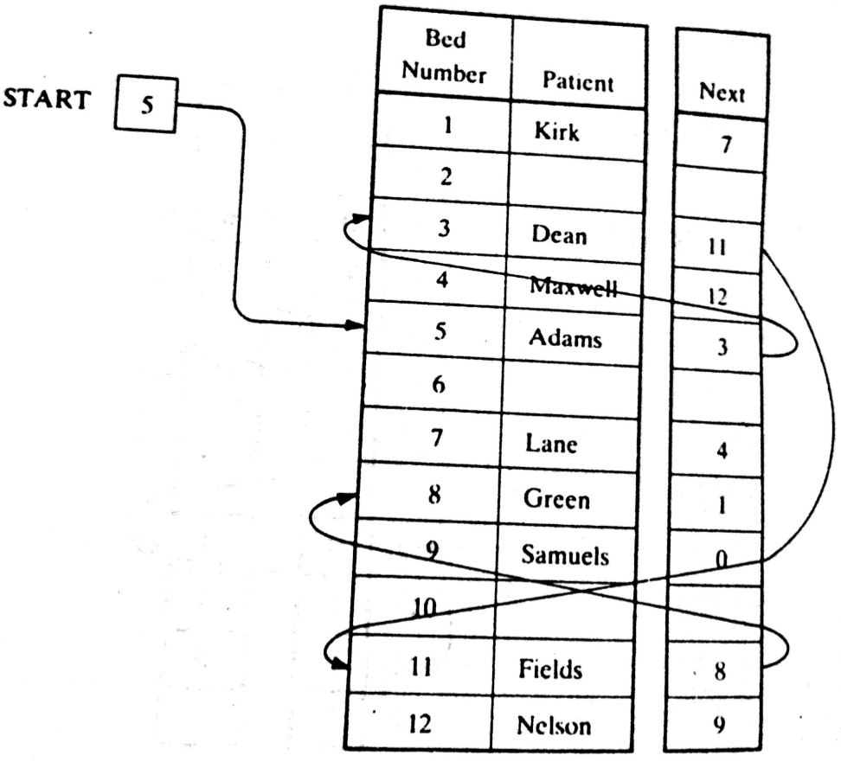
LINKED LISTS: Example

Slide 8
LINKED LISTS: Representation in Memory
Let LIST be a linked list which will be maintained in the memory
LIST requires…..
Two linear array,
    INFO[K]-Information part, and
    LINK[K]-nextpointer field of a node of LIST
A variable name-START, indicating the beginning of the LIST.
A nextpointer senitel-NULL, indicates the end of the LIST
Since, the subscripts of the array INFO and LINK will usually be positive, NULL=0, unless otherwise stated

Slide 9
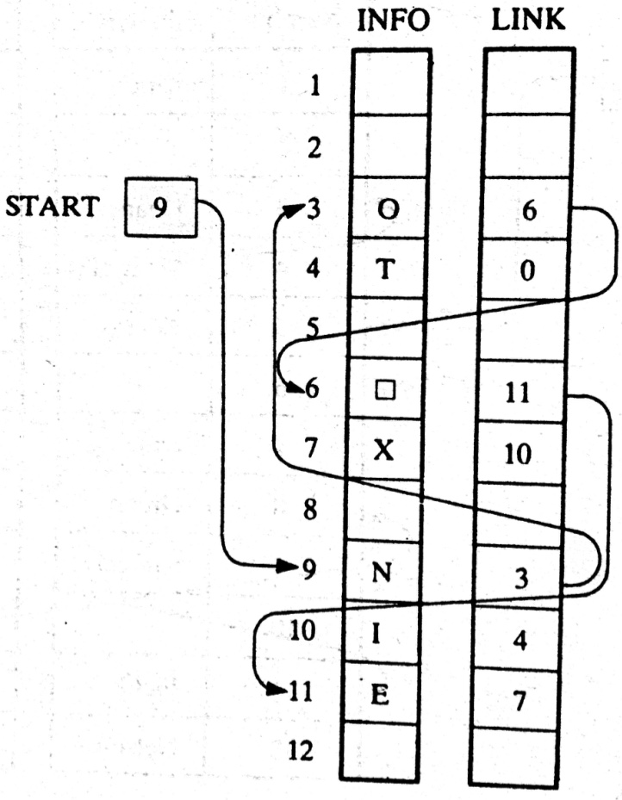
LINKED LISTS: Example
START=9, so INFO[9]= ?
LINK[9]=3, so, INFO[3]=?
LINK[3]=6, so, INFO[6]=?
LINK[6]=11, so, INFO[11]=?
LINK[11]=7, so, INFO[7]= ?
LINK[7]=10, so, INFO[10]= ?
LINK[10]=4, so, INFO[4]= ?
LINK[4]=0, so, INFO[0]= ?
N
0
⎕
E
X
I
T
NULL

Slide 10
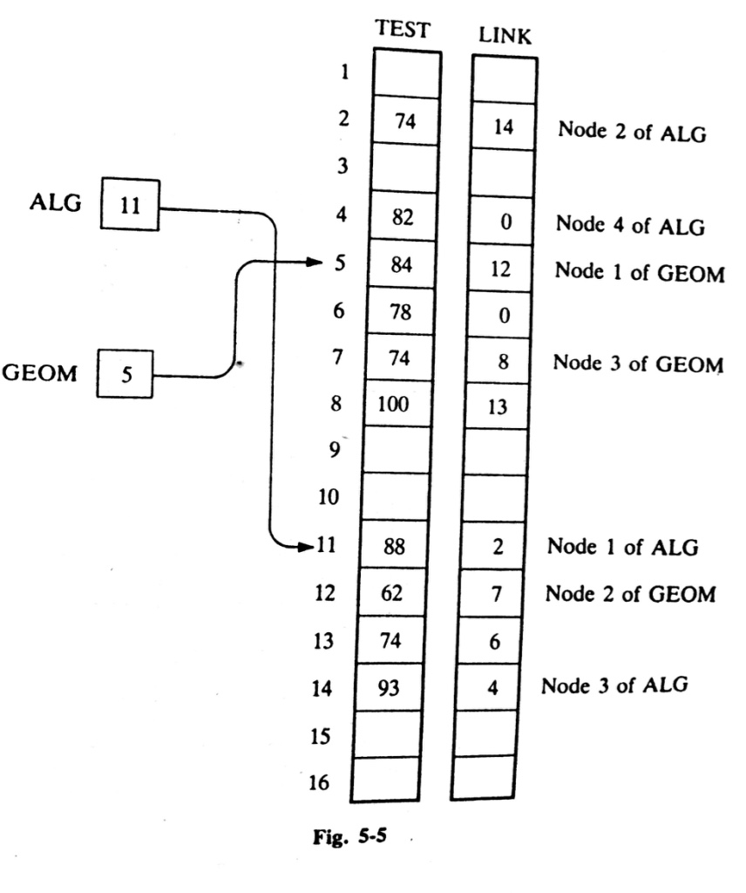
LINKED LISTS: Example
ALG consists of Test score:
88, 74, 93, 82
GEOM consists of Test score:
84, 62, 74, 100,74, 78

Slide 11
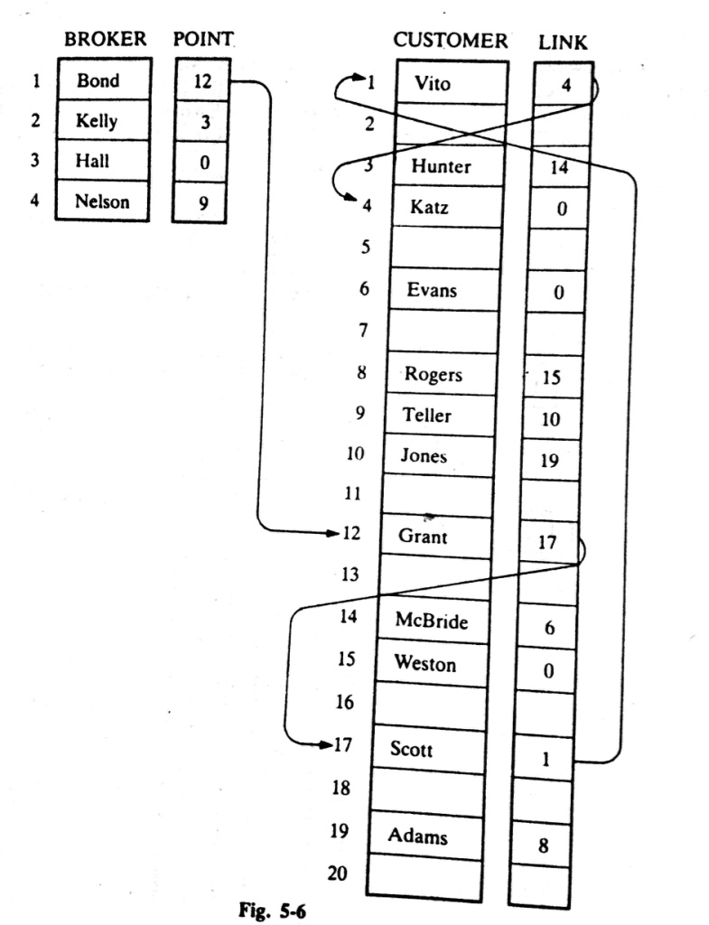
LINKED LISTS: Example
Bond’s list of customers:
Grant, Scott, Vito, Katz
Kelly’s list of customers:
Hunter, McBridge, Evans
Hall’s list of customers:
NULL / Empty List
Nelson’s list of customers:
Teller, Jones, Adams, Rogers, Weston

Slide 12
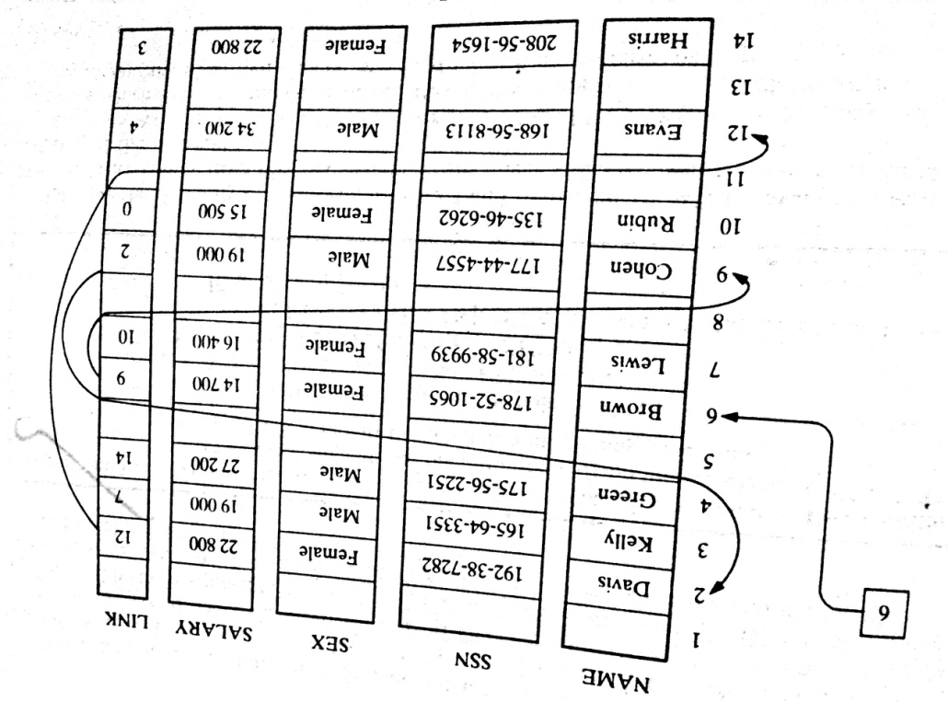
LINKED LISTS: Example
In general, the information part of a node may be a record with more than one data item.
In such a case, the data must be stored in some type of record structure or in a collection of parallel arrays.

Slide 13
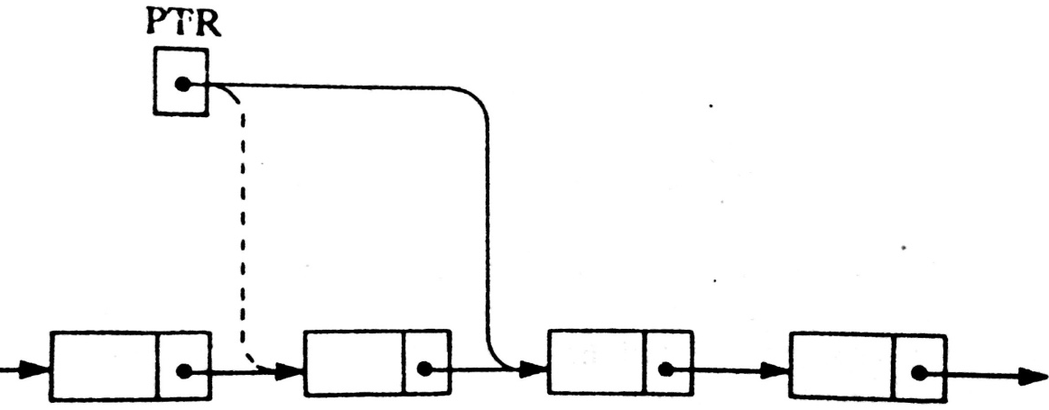
LINKED LISTS: Traversing
Let LIST be a linked list in memory stored in linear arrays INFO and LINK with START pointing to the first element and NULL indicating the end of LIST.
Traversing algorithm uses a pointer variable PTR which points to the node that is currently being processed.
Accordingly, LINK[PTR] points to the next node to be processed. Thus,
PTR:=LINK[PTR], moves the pointer to the next node in the list.

Slide 14
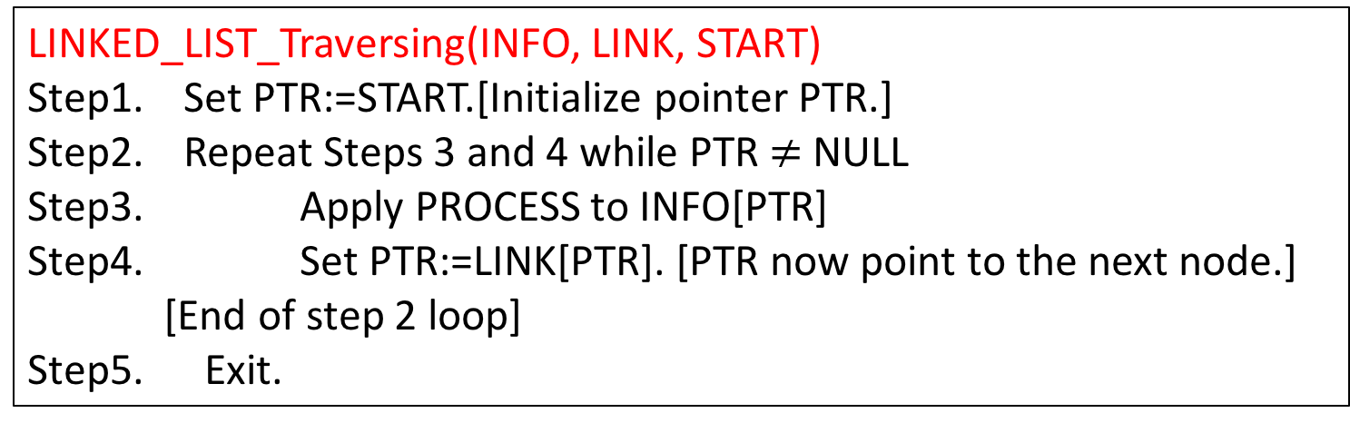
LINKED LISTS: Traversing Algorithm
Let LIST be a linked list in memory.
LINKED_LIST_Traversing(INFO, LINK, START)
Step1. Set PTR:=START.[Initialize pointer PTR.]
Step2. Repeat Steps 3 and 4 while PTR$≠$ NULL
Step3. Apply PROCESS to INFO[PTR]
Step4. Set PTR:=LINK[PTR]. [PTR now point to the next node.]
[End of step 2 loop]
Step5. Exit.
Any difference with Linear array traversing ??
LINEAR_ARRAY_Traversing
Step 1. [Initialize counter] Set K:=LB
Step 2. Repeat Step 3 and 4 while K<=UB [Repeat while loop]
Step 3. [Visit element] Apply PROCESS to A[K].
Step 4. [Increase counter] Set K:=K+1.
[End of Step 2 loop.]
Step 5. Exit.

Slide 15
Thank you……

